Slide 1

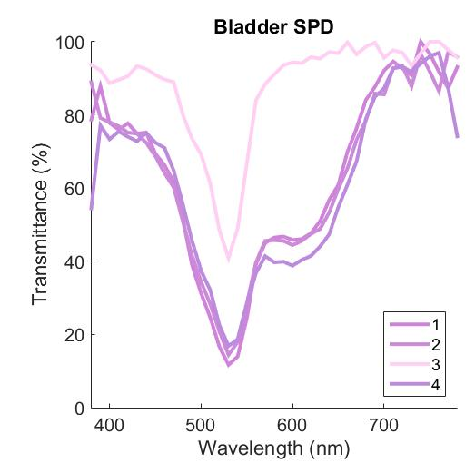
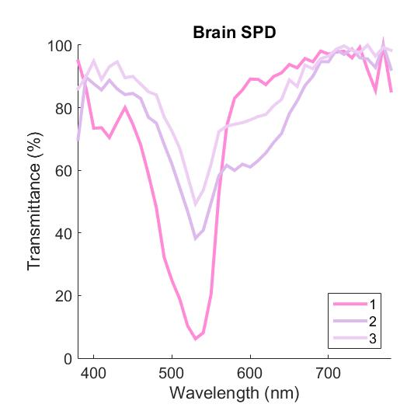
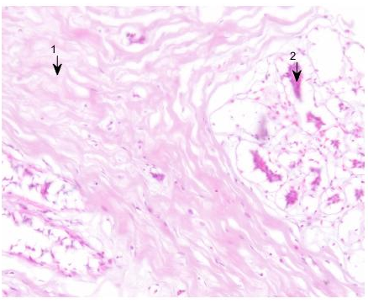
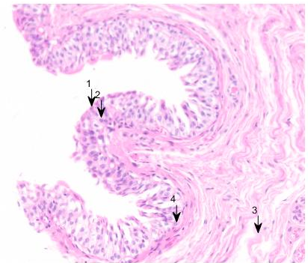
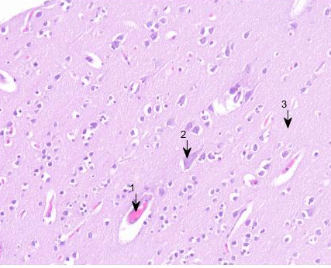
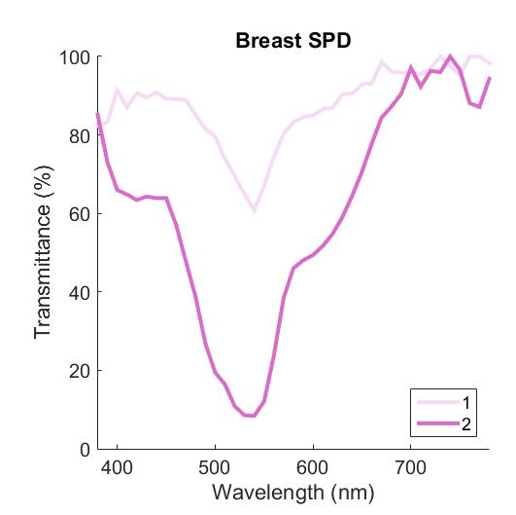
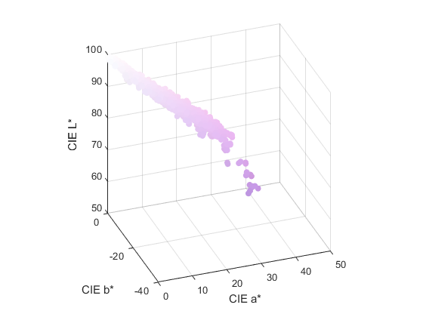
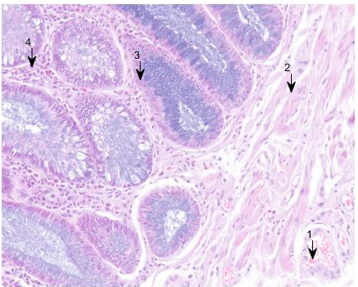
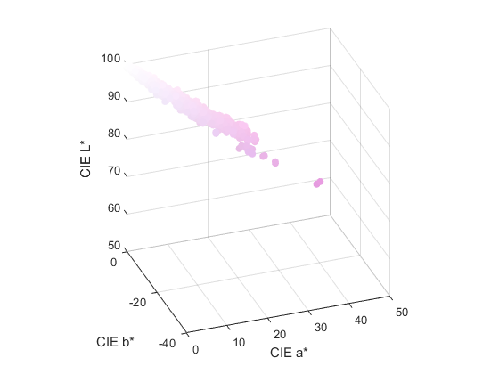
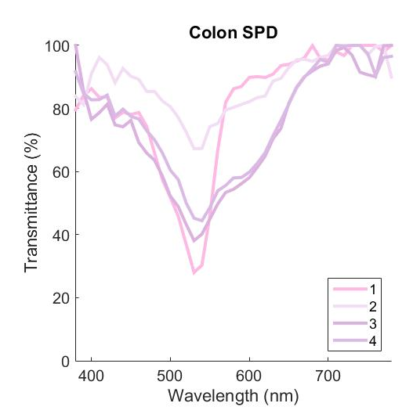
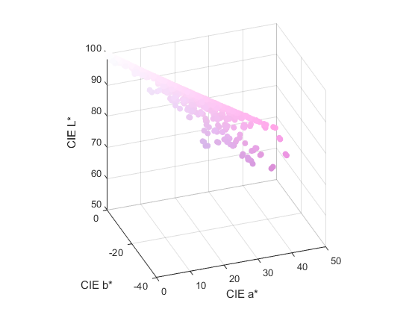
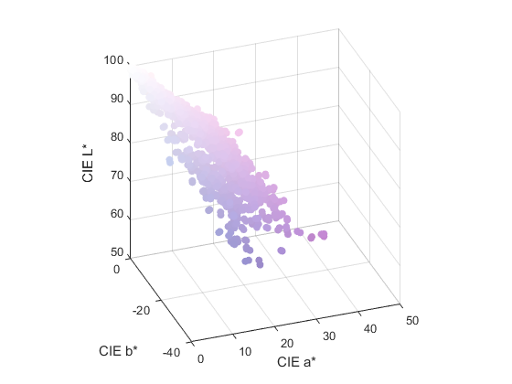
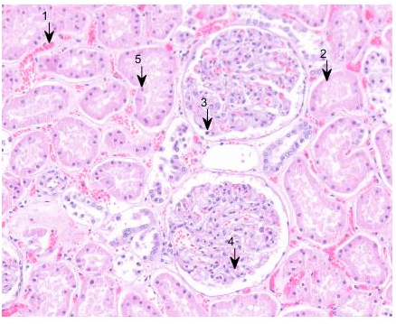
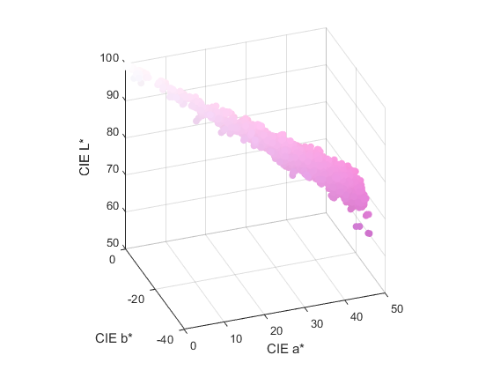
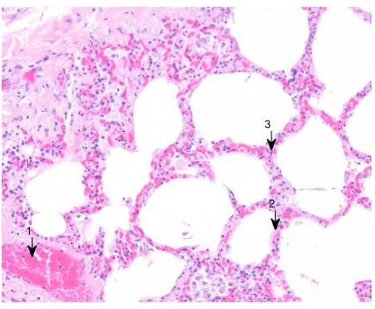
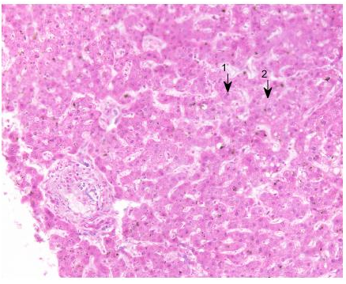
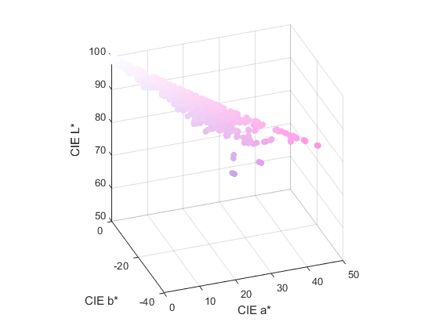
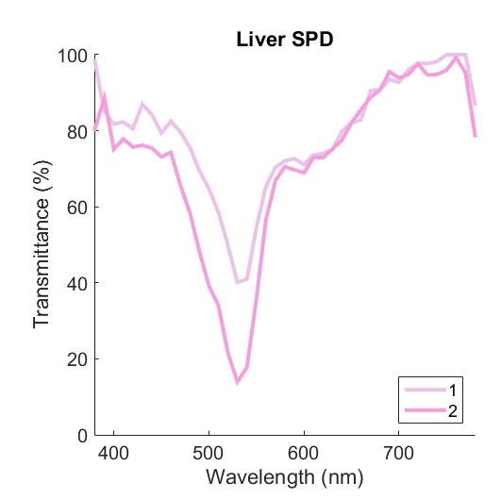
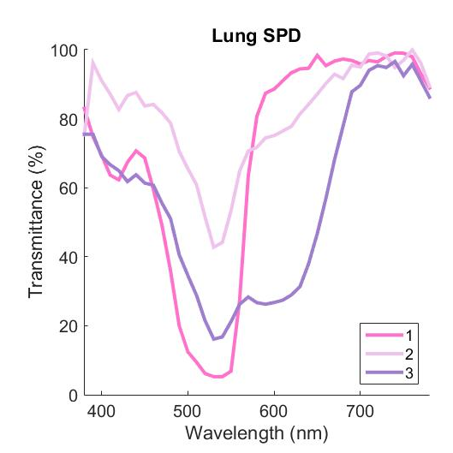
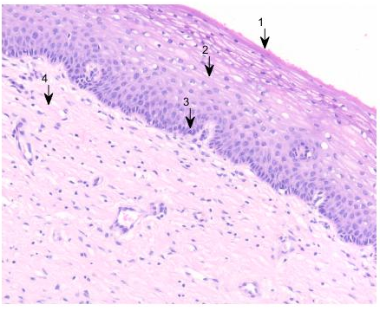
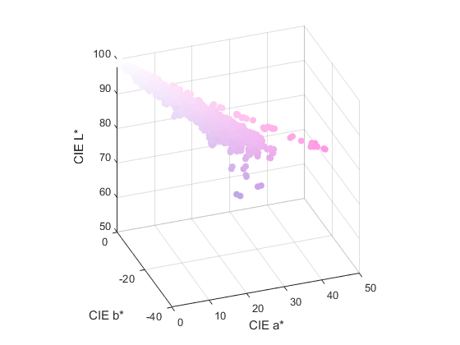
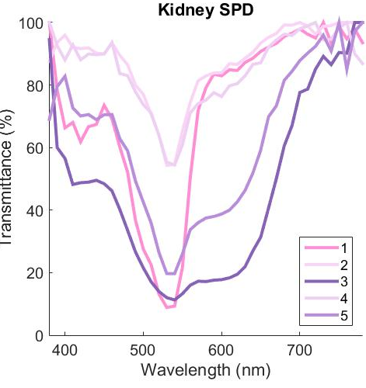
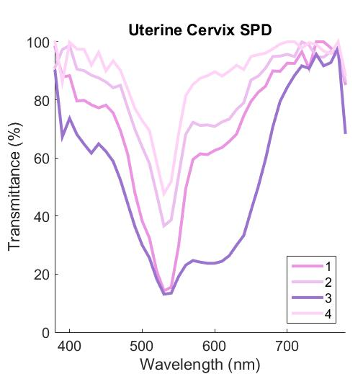
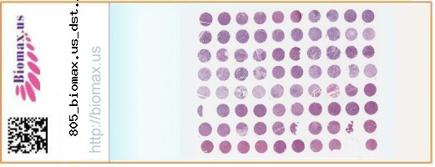
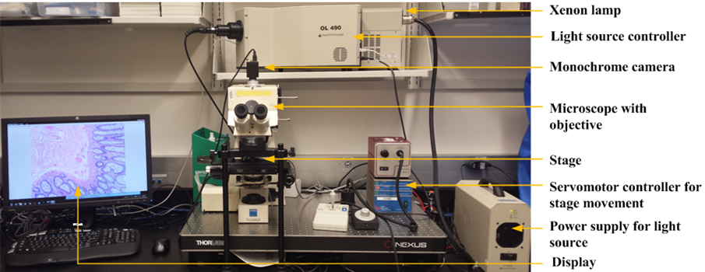
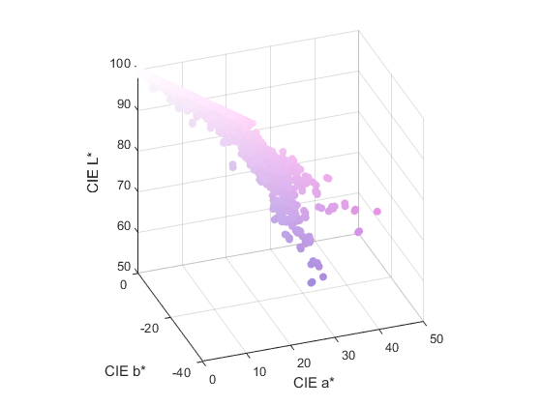
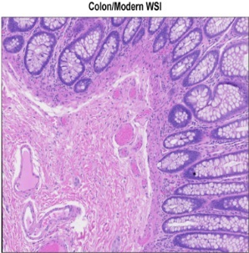
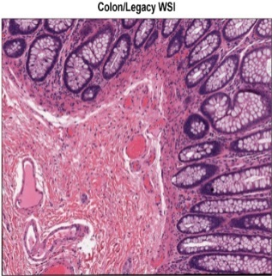
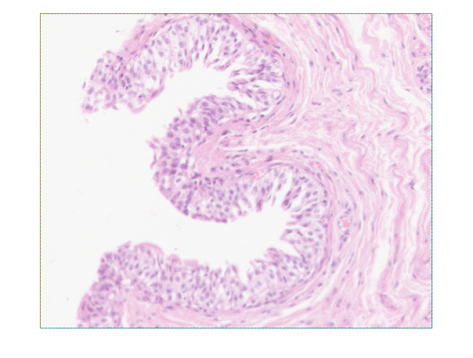
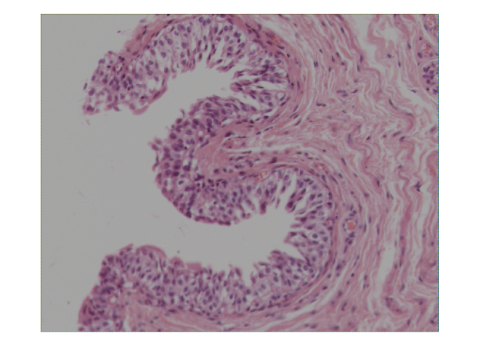
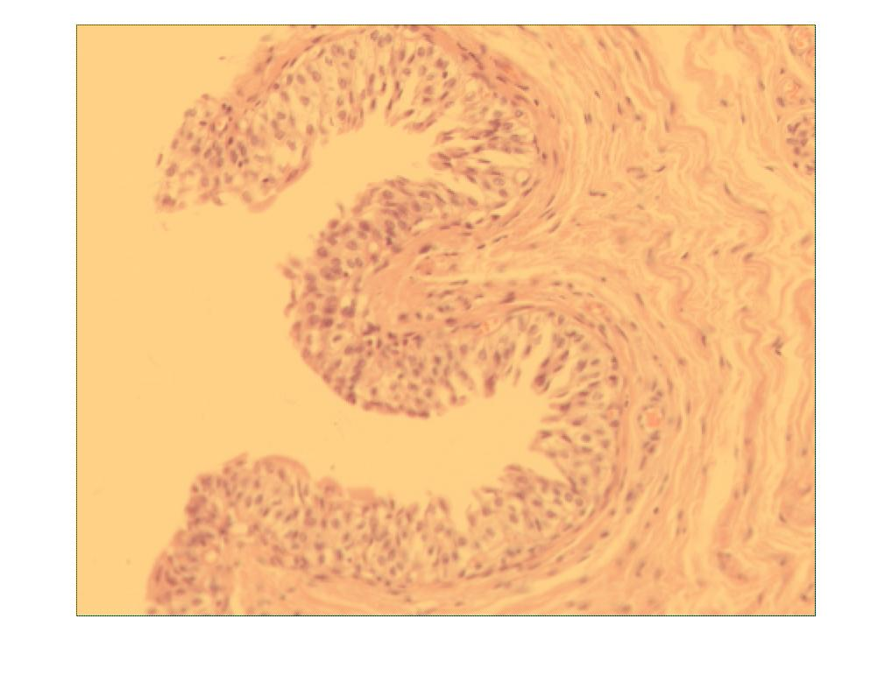
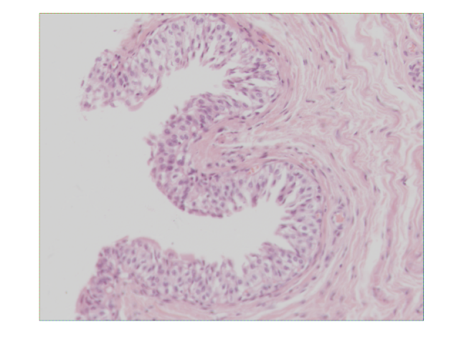
In-Silico Color Rendering Simulation for Whole-Slide Imaging Scanners with a Spectral Database of Human Tissues
Jocelyn Liu¹, Mary Barcus, MD², Wei-Chung Cheng, PhD³
¹Thomas Jefferson High School for Science and Technology, Alexandria, VA; ²CDRH/OIR/DMD, ³CDRH/OSEL/DIDSR
A digital phantom for Sponsors to demonstrate color performance of WSI devices
Clinical Area: Medical Imaging
REGULATORY RELEVANCE
SPECTRAL DATABASE RESULTS
Publically available digital phantoms allow Sponsors to simulate the output images of WSI devices and therefore simplify the required color performance tests.
Images reproduced from the spectral transmittance data of the eight tissue samples. The insets in each image shows spectra of sample cells and color distribution in CIELAB.
INTRODUCTION
Remotely assessing the color performance of whole-slide imaging (WSI) scanners is challenging for the Agency due to the lack of a standardized, histologically meaningful color phantom. In the past, Sponsors submitted calibration data or scanned images, which cannot be evaluated properly without the spectral information of the original glass slides. In this study, eight human tissue samples were measured with a multispectral imaging system to create a spectral database. Based on the spectral data, Sponsors can simulate and submit the output images, so the Agency can compare the data with predicate devices to determine substantial equivalence.
1: RBC’s
2: Muscularis mucosa
3: Epithelial cells (glandular)
4. Lamina propria
1: Superficial (umbrella) cells
2: Intermediate urothelial cells
3: Connective tissue
4: Basal urothelial cells
1: Blood vessel, RBC’s
2: Neuron
3: Neuropil
1: Connective tissue
2: Epithelial cells
(a) Bladder
(b) Brain
(c) Breast
(d) Colon
METHODS
1: RBC’s
2: Tubule, cytoplasm
3: Nucleus [glomerulus]
4: Cytoplasm [glomerulus]
5: Tubule, nucleus
Glass Slide [1]
1: Superficial cells
2: Intermediate cells
3: Basal cells
4: Stroma
1: Blood vessel, RBC’s
2: Alveolar walls (cytoplasm)
3: Alveolar walls (nuclei)
Multispectral Imaging System [2]
1: Hepatocyte, nucleus
2:Hepatocyte, cytoplasm
(e) Kidney
(f) Liver
(g) Lung
(h) Uterine cervix
Spectral Data [3]
COLOR RENDERING SIMULATION
CONCLUSION
Downloaded by Sponsor A
Downloaded by Sponsor B
A simulator was created to demonstrate how to use the spectral database. The simulator consists of eight stages to simulate the image signal processing (ISP) inside a color camera.
Digital slide phantoms provide a novel conduit for sharing and evaluating color performance of WSI devices. However, this database is limited in both its sampling size and the nature of the sampled tissues. Future endeavors should expand to a larger size and begin to sample tumor tissues, as well as include the usage of other medical stains such as PAS and Masson’s trichome which resolve different features and encompass larger color gamuts. We hope these public domain resources will provide a new means of efficiency and accessibility in remotely gauging WSI devices’ color performance.
WSI simulator
Predicate Device
WSI simulator
New Device
Light Source
Glass Slide (Digital Phantom)
Images from
Predicate Device
Images from
New Device
Infrared Filter
The Sponsors can tune the simulation parameters
to generate
the simulated images.
510(k)
submitted
510(k)
submitted
Color Filter Array
REFERENCES
?
=
Analog-Digital Converter
Ideal image
Gamma=1.0
[1] US Biomax, Inc., Rockville, MD, USA.
[2] Evaluating color performance of whole-slide imaging devices by multispectral-imaging of biological tissues, SPIE 2017.
[3] To be uploaded onto a GitHub repository.
[4] Mills, S. E. (Ed.). (2007). Histology for pathologists (3rd ed.). Philadelphia, PA: Lippincott. Williams & Wilkins.
De-Mosaicing
SE or NSE
Gamma
White Balancing (W.B.)
Poor W.B.
Halogen lamp
FUNDING SOURCE: ORISE
2018 OSEL Annual Student Science Poster Exhibit, August 1, 2018

